Slide 1
Patterns in Carbon TIME Classrooms: Learning Gains and Local Contexts
Christie Morrison Thomas, Qinyun Lin, Stefanie Marshall, James Brian Hancock II, Liz Tompkins & Andy Anderson
NARST Annual Meeting; April 2, 2019
Baltimore, Maryland
Notes:
Hi! I’m Christie Morrison Thomas, presenting our final Carbon TIME paper, titled [SLIDE] on behalf of our team, including [SLIDE].

Slide 2
Teachers Make a Difference
Ms. Callahan
Mr. Harris
Notes:
As we saw in Qinyun’s presentation, classrooms vary in terms of average student learning gains. [ANIMATE] Here we see Mr. Harris and Ms. Callahan – who we just met in Beth’s presentation – with lower and higher average learning gains, respectively. Their vignettes show how teachers’ patterns of classroom discourse also vary; in other words, Teachers Make a Difference.
[Figure shows average leaning gain scores for Ts who have taught S&S, PL & AN (n=52).]

Slide 3
Research Questions
How are teachers alike and different in what they understand their classroom work to be, as they teach Carbon TIME?
How do teachers’ local contexts affect this understanding and their related decisions?
What relationships connect what teachers say about their understanding of their classroom work and their local contexts with Carbon TIME classroom discourse patterns and student learning gains?
Notes:
And we want to know … WHY are there these differences? Toward this end, these 3 research questions focus our team’s work: [SLIDE]

Slide 4
Hypotheses about causal relationships: factors affecting classroom discourse
Teacher’s Practical Knowledge
Organizational Resources
Norms & Obligations
Notes:
We have hypotheses about factors that may impact the classroom discourse patterns we saw in Beth’s presentation. These include teacher’s practical knowledge, the organizational resources available in their local context, and the context’s norms and obligations.

Slide 5
Theoretical Framework: factors affecting classroom discourse
teachers’ practical knowledge of how (and why) to teach Carbon TIME units (van Driel, Beijaard & Verloop, 2001)
organizational resources (material, human, social) of the teachers’ schools and districts (Spillane, Diamond, Walker, Halverson, & Jita, 2001; Johnson, Kraft & Papay, 2012)
norms and obligations of teachers’ school professional communities (Danielson, 2014; Jackson, 1990; Kennedy, 2016; Spillane et al., 2001; Wenger, 1998)
Notes:
These three factors comprise our theoretical framework: [SLIDE]. We anticipated that these 3 variables would impact teachers’ understanding of Carbon TIME and their related decision-making, so we designed our network teacher interview protocol with these ideas, and interviewed 70 Carbon TIME network teachers last spring.

Slide 6
Attributes and Values Matrix
 | less support for Carbon TIME |  | more support for Carbon TIME
Practical Knowledge
Norms & Obligations
Organizational Resources
Notes:
We translated our theoretical framework into codes, to analyze our interviews, and we evaluated the 3 variables (or attributes) along a spectrum from less supportive of Carbon TIME to more supportive of Carbon TIME. This value matrix includes both the strength of the attribute as well as the alignment of the attribute to Carbon TIME perspectives.

Slide 7
Mr. Harris & Ms. Callahan
Mr. Harris
Ms. Callahan
Only Carbon TIME Network teacher at his school
One of 7 Biology teachers in his HS (that trimester)
Interview at end of 2nd year teaching Carbon TIME
One of 2 Carbon TIME Network teachers at her school
Only Biology teacher at her HS
Interview at the end of her 3rd year teaching Carbon TIME (1 year post-network)
Notes:
We’ll discuss our interview findings through the voices of Mr. Harris and Ms. Callahan, who you’ve already met in Beth’s presentation. Both were CTIME Network Teachers, participating in 2-years of data collection, teaching, and professional development. However, Mr. Harris is the only CTIME Network T at his school, while Ms. Callahan is one of 2 Network Teachers at her school. Mr. Harris was 1 of 7 Biology teachers in his HS (during just one trimester), while Ms. Callahan is the only biology teacher, and Ms. Callahan had one more year of CTIME teaching experience at the time of her interview.

Slide 8
Attributes and Values Matrix
 | less support for Carbon TIME |  | more support for Carbon TIME
Practical Knowledge
Norms & Obligations
Organizational Resources
Notes:
We’ll start by looking at interview responses from Mr. Harris and Ms. Callahan that represent their practical knowledge, or how they understand and use aspects of the Carbon TIME toolkit in their classrooms. Their interview descriptions coordinate with differences we see in the discourse patterns in their classrooms, particularly around scaffolding and assessment.

Slide 9
Mr. Harris: Practical Knowledge
Mr. Harris
low support for
teaching Carbon TIME
more support for
teaching Carbon TIME
Coded Excerpts: Practical Knowledge
Notes:
First, an explanation for the table that you see: Each row represents an excerpt – a chunk – from the overall interview that has been coded with this particular attribute. In this case, we found “practical knowledge” discussed in 9 excerpts/chunks in Mr. Harris’ interview, so there are 9 rows in this table. The blue shading and its placement from left to right represent a value for this variable, from less to more support for teaching Carbon TIME.
In this representation, we can see that Mr. Harris' descriptions of how he teaches with Carbon TIME align fairly well with our perspective. Throughout his interview, Mr. Harris talks about Ss reflecting on their previous ideas and he talks specifically about helpful aspects of the Carbon TIME toolkit, such as The Three Questions. However, as we’ll see next, he struggles with the UAQ on the Evidence-Based Arguments Tool, which – in CTIME – is a critical place in the unit. You’ll notice that the quotes we share, though representative of the overall values in the interview, were intentionally selected in an attempt to succinctly compare these two teachers.

Slide 10
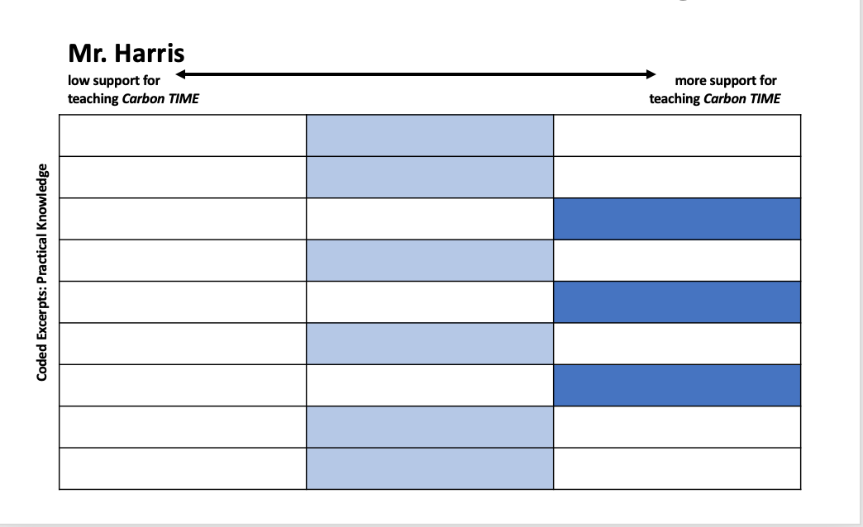
Mr. Harris: Practical Knowledge
“The unanswered questions … I’m like, ‘I don’t know what unanswered questions I would have.’ Because the kids are always saying things like, ‘Well, what’s - what are the chemicals in BTB?’ I’m like, ‘Okay well that’s not - that’s not what we’re going for.’”
Notes:
Mr. Harris says [SLIDE]. As Beth showed earlier in her slides, the UAQ that we ARE going for in this unit include ideas like “What types of molecules were atoms in when they went into and left the flame?” Mr. Harris' quote helps us see that he's struggling to understand how to teach with CTIME, which impacts his classroom decisions.

Slide 11
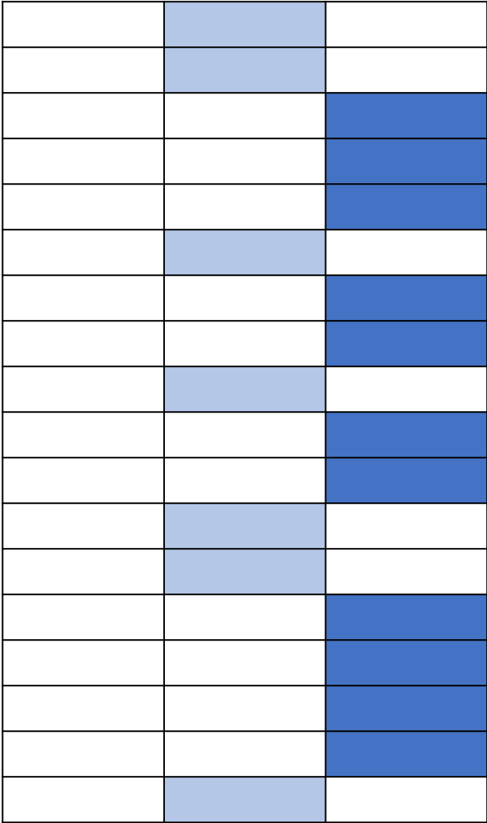
Ms. Callahan: Practical Knowledge
Ms. Callahan
low support for
teaching Carbon TIME
more support for
teaching Carbon TIME
Coded Excerpts: Practical Knowledge
Notes:
Like Mr. Harris, Ms. Callahan expresses practical knowledge about teaching Carbon TIME in her classroom in ways that largely align with our perspective. What we see in her interview that is different than Mr. Harris’ is her focus on Ss 3-dimensional performances – not just their ideas, but their engagement in roles as authentic questioners, investigators and explainers.

Slide 12
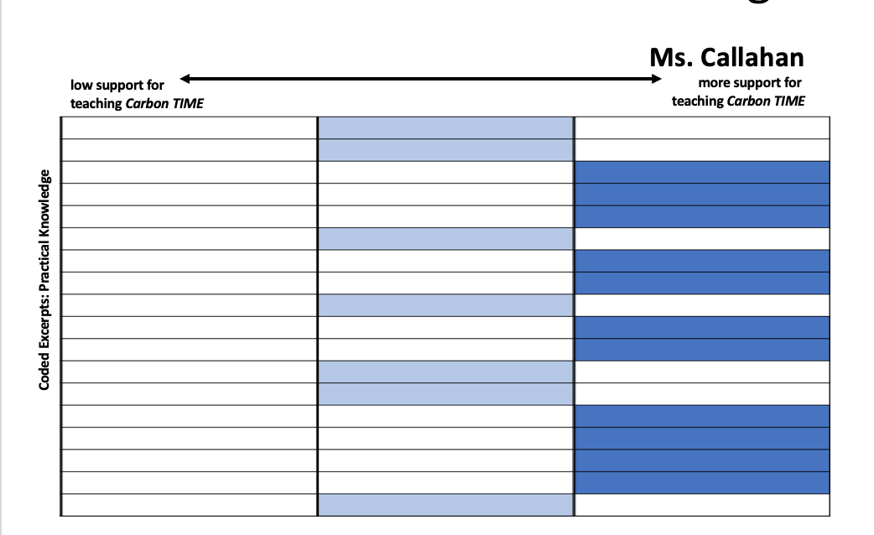
Ms. Callahan: Practical Knowledge
“I personally appreciate the questioning. I love starting out with them with here’s the phenomenon, ‘What do you guys think is happening? What is going to go on?’ Before we do the lab, looking into Predictions Tools, making them actually conscientiously think about what are we looking for when we do a lab. Doing the lab is important, the molecular modeling I think is critical. The PPTs are a little less, I think, important.”
Notes:
For example, Ms. Callahan says [SLIDE]. We would agree – the PPTs are less important than these other aspects of the CTIME toolkit.

Slide 13
Attributes and Values Matrix
 | less support for Carbon TIME |  | more support for Carbon TIME
Practical Knowledge
Norms & Obligations
Organizational Resources
Notes:
Next, we’ll look at the teachers’ responses around norms and obligations, which reflect both “what it’s like” in the department, school, or district, and what teachers feel accountable for or to.

Slide 14
Mr. Harris: Norms & Obligations
Mr. Harris
low support for
teaching Carbon TIME
more support for
teaching Carbon TIME
Coded Excerpts: Norms & Obligations
Notes:
For Mr. Harris, local norms and obligations do not provide much support for teaching with Carbon TIME. He struggles with a trimester schedule and a course-level common assessment that he feels constrain his ability to teach with Carbon TIME.

Slide 15
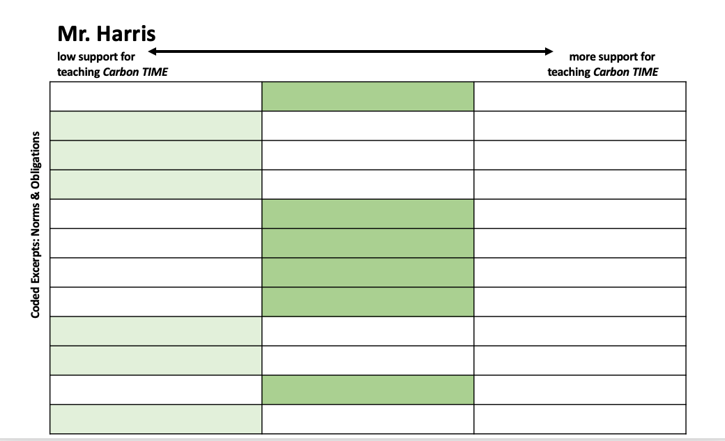
Mr. Harris: Norms & Obligations
“Because we are all so very good at - at giving the notes, doing the lab, move on. And then you tell the kids, “Study the notes.” And when they study the notes, look like, a test. They did well.”
Notes:
In talking about norms for teaching in his science department, he says [SLIDE]. For Mr. Harris, this norm for teaching in traditional, 1-dimensional ways corresponds with an obligation to a long, multiple-choice, fact-oriented common assessment.

Slide 16
Ms. Callahan: Norms & Obligations
Ms. Callahan
low support for
teaching Carbon TIME
more support for
teaching Carbon TIME
Coded Excerpts: Norms & Obligations
Notes:
On the other hand, as we can see in this matrix, Ms. Callahan finds the norms and obligations of her local context to provide more support for Carbon TIME.

Slide 17
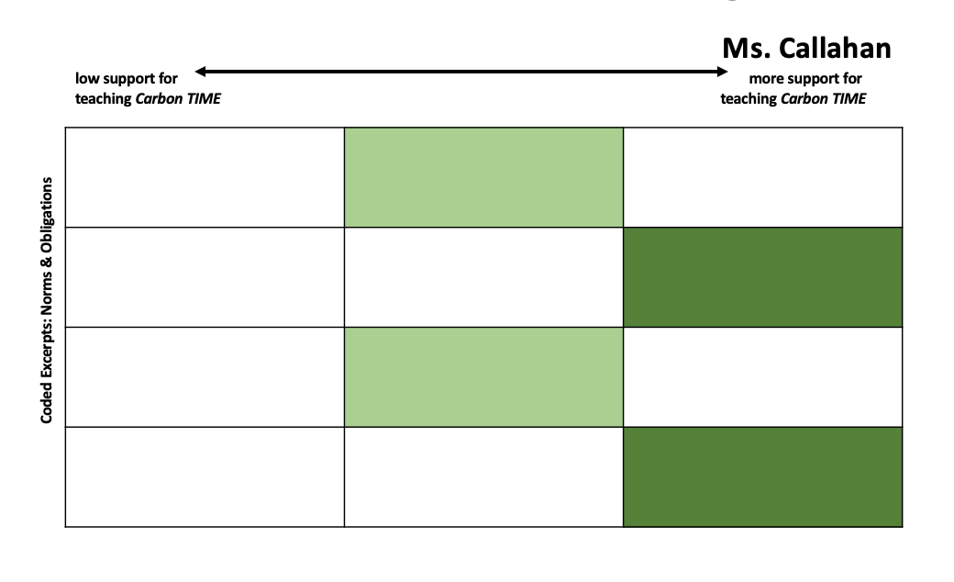
Ms. Callahan: Norms & Obligations
“this Carbon TIME stuff is really fantastic for [my curriculum director] because it’s about themes and ideas and big processes, and how do those overlap. Because we’re not talking just about what a worm eats, we’re talking about so much more than just biology. We’re getting into so many different parts that are happening that is interdisciplinary, and so he loves that component to it, which is really kind of cool.”
Notes:
For example, she says [SLIDE]. This shows how CTIME meets expectations in her local context.

Slide 18
Attributes and Values Matrix
 | less support for Carbon TIME |  | more support for Carbon TIME
Practical Knowledge
Norms & Obligations
Organizational Resources
Notes:
We also see examples in the teachers’ interview responses describing their organizational resources – the material, human, and social resources within their departments, schools, and districts.

Slide 19
Mr. Harris: Organizational Resources
Mr. Harris
low support for
teaching Carbon TIME
more support for
teaching Carbon TIME
Coded Excerpts: Organizational Resources
Notes:
Mr. Harris’ comments suggest that there is generally low-to-moderate organizational support for Carbon TIME. Though his science department has engaged recently with inquiry-oriented professional development, he feels like the transition toward “figuring out” pedagogy is challenging for himself and his peers, and he doesn’t feel that he has colleagues around him with resources that support his use of Carbon TIME.

Slide 20
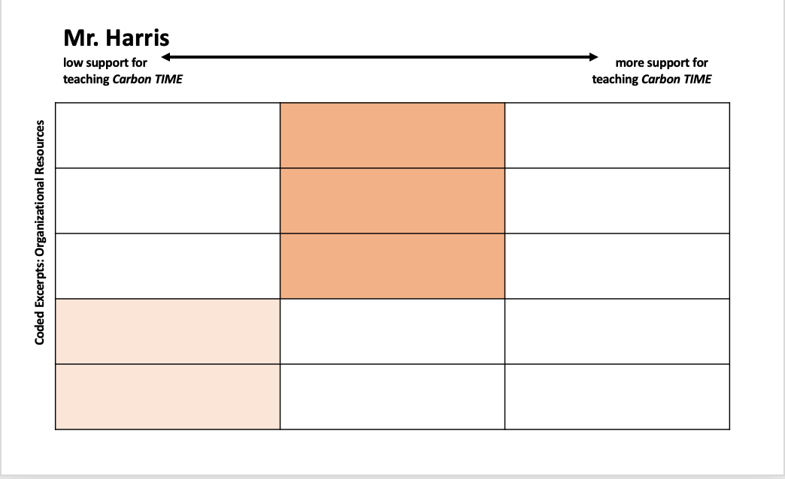
Mr. Harris: Organizational Resources
“We have another teacher doing Carbon TIME. She was in her first year this year. But, same thing, it’s hard to get proficient at it, because she just has a few classes of it.”
Notes:
Specifically, he indicates, [SLIDE]

Slide 21
Ms. Callahan: Organizational Resources
Ms. Callahan
low support for
teaching Carbon TIME
more support for
teaching Carbon TIME
Coded Excerpts: Organizational Resources
Notes:
Differently, Ms. Callahan’s interview shows much higher levels of organizational resources in support of using Carbon TIME.

Slide 22
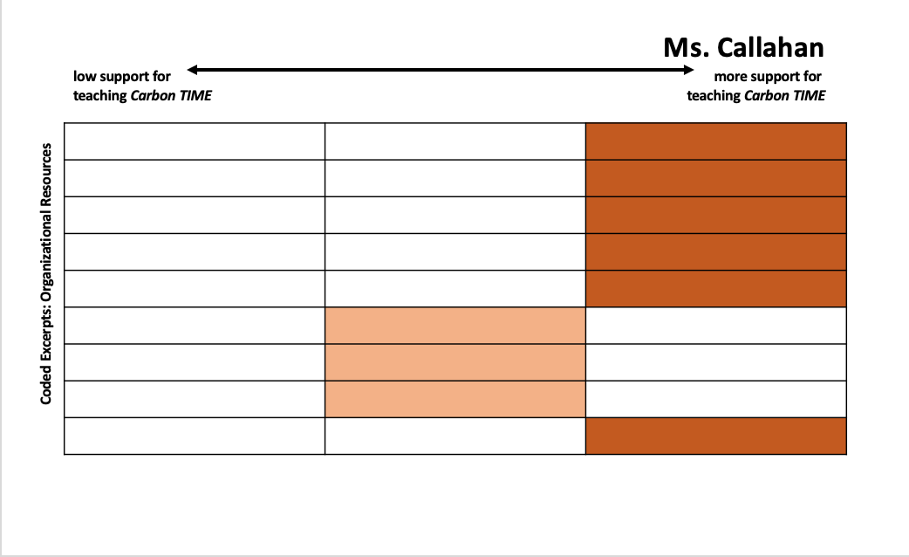
Ms. Callahan: Organizational Resources
“a teacher in my district … teaches 3 of the other units [with] her AP Environmental Science course, so it’s really neat for the students to have that connection of potentially getting exposure to 4 or 5 of the Carbon TIME units at different times in their life.”
Notes:
For example, Ms. Callahan has a Carbon TIME colleague in her building who has expertise: [SLIDE].

Slide 23
Attributes and Values Matrix
 | less support for Carbon TIME |  | more support for Carbon TIME
Practical Knowledge
Norms & Obligations
Organizational Resources
Mr. Harris
Ms. Callahan
Notes:
Taken together, the variables for Mr. Harris (represented with blue-outlined rectangles) and Ms. Callahan (black-outlined rectangles), provide a picture of teachers with differing amounts of support for Carbon TIME.

Slide 24
Theoretical Framework: factors affecting classroom discourse
teachers’ practical knowledge of how (and why) to teach Carbon TIME units (van Driel, Beijaard & Verloop, 2001)
organizational resources (material, human, social) of the teachers’ schools and districts (Spillane, Diamond, Walker, Halverson, & Jita, 2001; Johnson, Kraft & Papay, 2012)
norms and obligations of teachers’ school professional communities (Danielson, 2014; Jackson, 1990; Kennedy, 2016; Spillane et al., 2001; Wenger, 1998)
teachers’ frames for approaching student motivation and mastery and of themselves (as teachers) (Russ, Lee & Sherin, 2012)
Notes:
Along with evidence that these 3 factors may be affecting classroom discourse, our interview responses are providing us with information that we didn’t specifically ask about. We perceive that teachers are sharing their perspective on their students’ motivation toward mastering complex 3-dimensional performances, as well as stories about themselves as teachers. We therefore included an additional coding variable around framing. I will say that we’re definitely still working on identifying patterns and making sense of this framing aspect; your ideas are – of course – welcome.

Slide 25
Attributes and Values Matrix
 | less support for Carbon TIME |  | more support for Carbon TIME
Practical Knowledge
Norms & Obligations
Organizational Resources
T Frame: Motivation vs. Mastery
T Frame: Teacher’s Story
Notes:
This image shows all 5 coding variables, with less to more support for teaching Carbon TIME. [ANIMATE] Next, we’ll see examples of Mr. Harris and Ms. Callahan’s framing for Motivation vs. Mastery. With this idea, we’re looking beyond the teachers’ understanding of how to use Carbon TIME in their classroom (which we have already discussed as practical knowledge) to their stories about learning goals and target performances for students.

Slide 26
Mr. Harris: Motivation vs. Mastery
Mr. Harris
low support for
teaching Carbon TIME
more support for
teaching Carbon TIME
Coded Excerpts: Motivation vs. Mastery
Notes:
Mr. Harris does describe mastery-oriented goals for conceptual understanding as worthwhile, however he focuses more on 1- or 2-dimensional descriptions of mastery, not 3-dimensional performances. Additionally, his responses suggest that he does not necessarily perceive Ss to be motivated toward mastery learning goals.

Slide 27
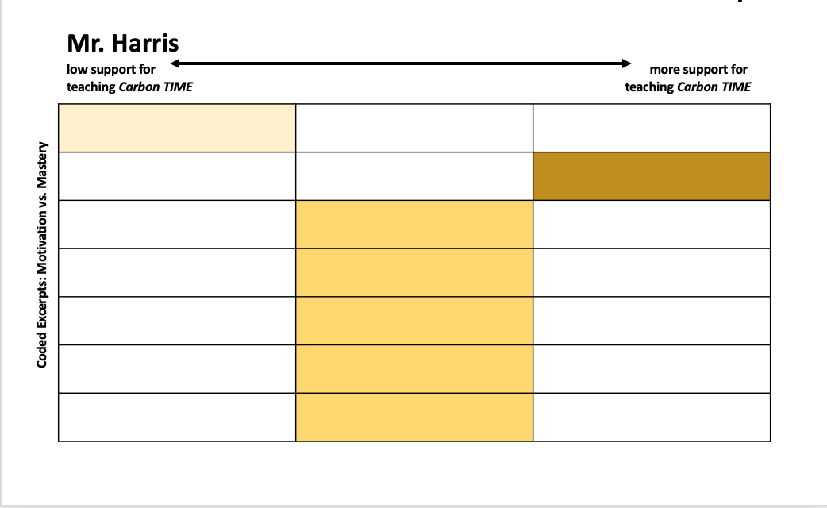
Mr. Harris: Motivation vs. Mastery
“but with that we realize that kids do not have the endurance to think. They really think they should read [an assessment item] and put A, B, C, or D. Like, that’s what they want to do, and if you have to think then … they do not have endurance.”
Notes:
A case in point is his discussion of student assessments, in which Mr. Harris says [SLIDE]

Slide 28
Ms. Callahan: Motivation vs. Mastery
Ms. Callahan
low support for
teaching Carbon TIME
more support for
teaching Carbon TIME
Coded Excerpts: Motivation vs. Mastery
Notes:
Differently, Ms. Callahan’s interview responses suggest that she perceives learning goals to be performance-oriented: Ss are asking their own questions, finding their own explanations, and improving both their practices and their understanding. She also perceives Ss to be motivated toward this deep engagement and mastery. Her comments are more highly aligned with CTIME than Mr. Harris.

Slide 29
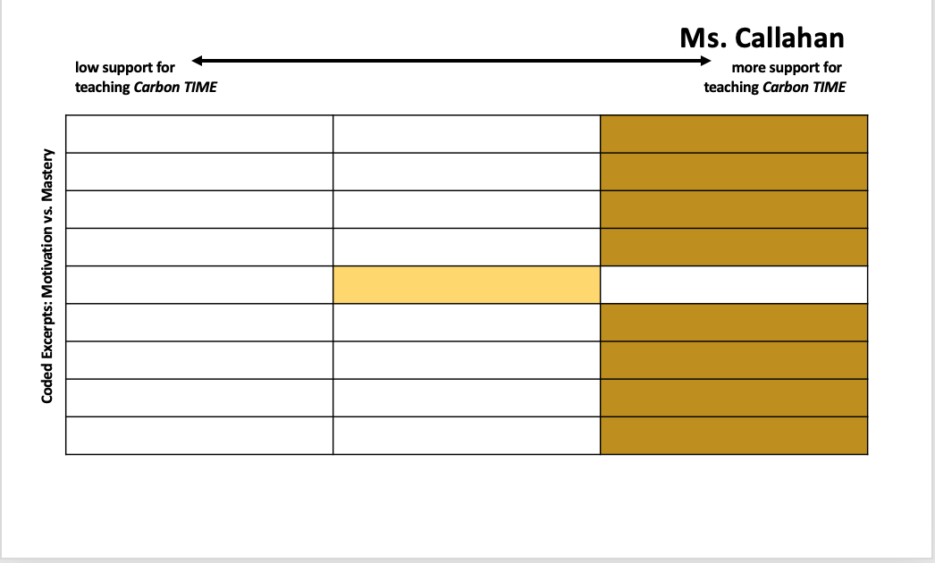
Ms. Callahan: Motivation vs. Mastery
“It’s so good for them, and they know too, we do spend a decent amount of time at the end of the unit… going back and saying, ‘How have you grown? How have your ideas changed? How are you much more clear in rewriting your explanations?’ So they see the reward in it.”
Notes:
Ms. Callahan says, [SLIDE]

Slide 30
Attributes and Values Matrix
 | less support for Carbon TIME |  | more support for Carbon TIME
Practical Knowledge
Norms & Obligations
Organizational Resources
T Frame: Motivation vs. Mastery
T Frame: Teacher’s Story
Notes:
Finally, we’ll look at how – throughout their interview conversations with us – teachers shared a story about themselves.

Slide 31
Mr. Harris: Teacher’s Story
Mr. Harris
low support for
teaching Carbon TIME
more support for
teaching Carbon TIME
Coded Excerpts: Teacher’s Story
Notes:
Here, we see moderate alignment among Mr. Harris’ statements and Carbon TIME. He shares a realization that his students weren’t understanding carbon-transforming processes before he taught with Carbon TIME.

Slide 32
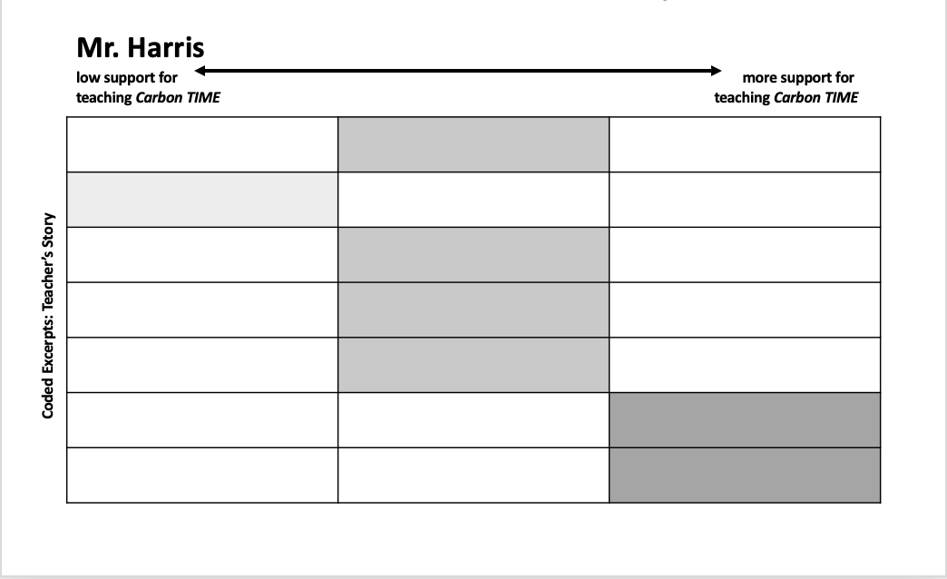
Mr. Harris: Teacher’s Story
“Just like teachers I talked about, I’m still worried about cutting content. Because I know NGSS talks about broad, and phenomena, and understanding conceptually, but even as I criticize others, I’m scared to cut content and spend more time going into depth, just because it’s a challenge.”
Notes:
Yet, he also provides a very honest assessment of his current situation: [SLIDE]

Slide 33
Ms. Callahan: Teacher’s Story
Ms. Callahan
low support for
teaching Carbon TIME
more support for
teaching Carbon TIME
Coded Excerpts: Teacher’s Story
Notes:
Meanwhile, Ms. Callahan’s interview responses suggest that her vision for students’ 3-dimensional engagement around natural phenomena align with Carbon TIME target performances, and she perceives Ss as motivated toward this deep engagement and mastery.

Slide 34
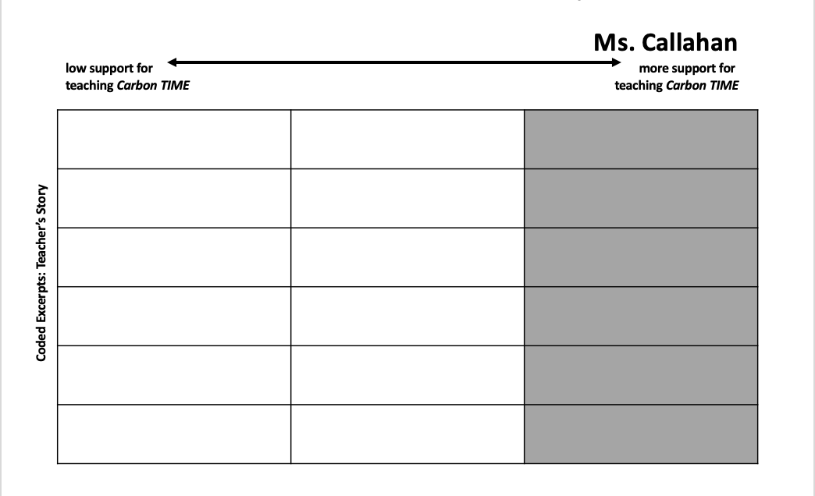
Ms. Callahan: Teacher’s Story
“I always taught units on photosynthesis and respiration, but never really put it at much past ‘then let’s understand electron transport chain.’ So I think this emphasis on really understanding this universe, how things grow, how things change, how things are alive and how they’re not, that happens through Carbon TIME - is something that I didn’t teach before.”
Notes:
Ms. Callahan shares changes in her perspective as a teacher that match CTIME’s goals of students’ 3-dimensional engagement with natural phenomena. [SLIDE]

Slide 35
Attributes and Values Matrix
 | less support for Carbon TIME |  | more support for Carbon TIME
Practical Knowledge
Norms & Obligations
Organizational Resources
T Frame: Motivation vs. Mastery
T Frame: Teacher’s Story
Mr. Harris
Ms. Callahan
Notes:
Looking across all of our attributes, we see – again – Mr. Harris has less support for Carbon TIME while Ms. Callahan has more support for CTIME.

Slide 36
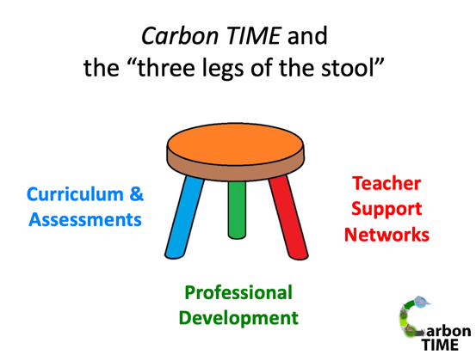
Implications
How can we use the “3 legs of the stool” to help shift teachers’ practice toward 3-dimensional engagement with natural phenomena?
Notes:
We think these findings have implications for considering this question [SLIDE]
We mean … How can we use educative curriculum and assessments, coordinated professional development, and teacher support networks within organizational systems that already exist with norms, obligations, and resources that may or may not align with or provide for 3-dimensional engagement with phenomena? As well as, How do we recognize and support teachers who are different?

Slide 37
Continuing Data Analysis
Comparing interviews for teachers within “the same” local context (together in schools/districts)
46 of 70 teacher interviews represent 14 districts
Cross-data set analyses: Network Teacher Surveys and Case Study Teacher data sets
Toward development of teacher progressions: classroom discourse and teacher knowledge and framing
Notes:
As we continue to analyze our interview data, we will be comparing findings for teachers within "the same" local context - meaning they teach together in the same school or district. And, actually, 46 of our 70 interviews are of teachers with other CTIME network teachers in their districts. Additionally, we’ll be working further on cross-set data analyses, including making comparisons across network teacher interviews and survey data, as well as with classroom video and other components of our Case Study Teacher data sets. [ANIMATE] We hope that these continued analyses will support us in developing evidence-based teacher progressions around both classroom discourse and teacher knowledge and framing.

Slide 38
Thank you! We welcome your discussion and questions.
http://carbontime.bscs.org
Notes:
[SLIDE]

Slide 39
References
Danielson, C. (2014). The framework for teaching evaluation instrument, 2013 edition. The Danielson Group. Retrieved from www. danielsongroup.org
Jackson, P. W. (1990). Life in classrooms. Teachers College Press.
Kennedy, M. (2016). Parsing the practice of teaching. Journal of Teacher Education, 67(1), 6–17.
Johnson, S. M., Kraft, M. A. & Papay, J. P. (2012). How context matters in high-need schools: The effects of teachers’ working conditions on their professional satisfaction and their students’ achievement. Teachers College Record, 114(10), 1–39.
Russ, R. S., Lee, V. R., & Sherin, B. L. (2012). Framing in cognitive clinical interviews about intuitive science knowledge: Dynamic student understandings of the discourse interaction. Science Education, 96(4), 573-599.
Spillane, J. P., Diamond, J. B., Walker, L. J., Halverson, R., & Jita, L. (2001). Urban school leadership for elementary science instruction: Identifying and activating resources in an undervalued school subject. Journal of Research in Science Teaching, 38(8), 918-940.
Van Driel, J. H., Beijaard, D., & Verloop, N. (2001). Professional development and reform in science education: The role of teachers' practical knowledge. Journal of Research in Science Teaching, 38(2), 137–158.
Wenger, E. (1998). Communities of practice: Learning, meaning, and identity. Cambridge: Cambridge University Press.

Slide 40
Thanks to our funders
This research is supported by a grant from the National Science Foundation: Sustaining Responsive and Rigorous Teaching Based on Carbon TIME (NSF 1440988 ). Any opinions, findings, and conclusions or recommendations expressed in this material are those of the author(s) and do not necessarily reflect the views of the National Science Foundation.
Notes:
And thanks to the National Science Foundation for funding this research.

